Slide 1
Support Vector Machine

Slide 2
Statistical Learning Theory
Systems can be mathematically described as:
i.Receives data (observations) as input and
ii.Outputs a function that can be used to predict some features of future data.
Statistical learning theory models this as a function estimation problem
Generalization Performance (accuracy in labeling test data) is measured.

Slide 3
Motivation for SVM
•The problem to be solved is one of the supervised binary classification. That is, we wish to categorize new unseen objects into two separate groups based on their properties and a set of known examples, which are already categorized.
•A good example of such a system is classifying a set of new documents into positive or negative sentiment groups, based on other documents which have already been classified as positive or negative.
•Similarly, we could classify new emails into spam or non-spam, based on a large corpus of documents that have already been marked as spam or non-spam by humans. SVMs are highly applicable to such situations.

Slide 4
Introduction
Support Vector Machine is a supervised classification method that separates data using Hyperplanes.
It draws the decision boundary between data instances plotted in the multi-dimensional feature spaces.
Hyperplane is the generalization of a plane.
i.In one dimension, a hyperplane is called a point
ii.In two dimensions, it is a line
iii.In three dimensions, it is a plane
iv.In more dimensions you can call it a hyperplane

Slide 5
Introduction
The objective of the support vector machine algorithm is to find a hyperplane in an N-dimensional space(N — the number of features) that distinctly classifies the data points.
Let us consider an example that the data instances are linearly separable.
Thus when mapped in a two-dimensional space,the data instances belonging to different classes fall in different sides of a straight line drawn in the two-dimensional space.
If the same concept is extended to a multi-dimensional feature space,the straight line dividing data instances belonging to different classes transform to a hyperplane.

Slide 6
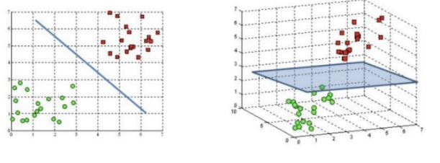
Representation
Two-dimensional feature space Multi-dimensional feature space

Slide 7
Classification using SVM
Thus an SVM Model is a representation of the input instances as points in the feature space,which are mapped so that an apparent gap between them divides the instances of the separate classes.
Hyperplanes are the decision boundaries that help classify the data points. Data points falling on either side of the hyperplane can be attributed to different classes.
Also, the dimension of the hyperplane depends upon the number of features. If the number of input features is 2, then the hyperplane is just a line. If the number of input features is 3, then the hyperplane becomes a two-dimensional plane.

Slide 8
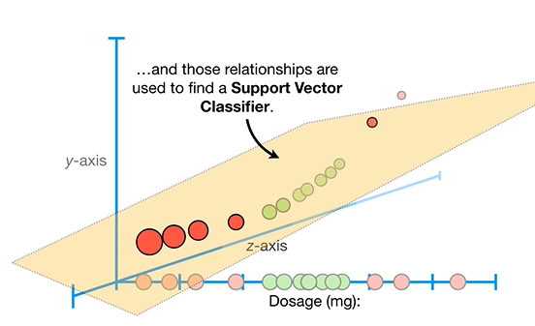

Slide 9
Classification using SVM
Goal of the SVM analysis find a plane,or rather a hyperplane,which separates the instances on the basis of their classes.
New instances are mapped to same space and predicted to belong to a class on which side of gap the new instance will fall on.
To separate the two classes of data points, there are many possible hyperplanes that could be chosen. Our objective is to find a plane that has the maximum margin, i.e the maximum distance between data points of both classes.

Slide 10
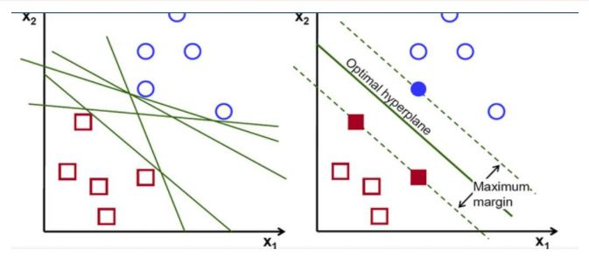
Classification using SVM

Slide 11
Support Vectors
Support vectors are the data points(representing classes) that are closer to the hyperplane and influence the position and orientation of the hyperplane.
Using these support vectors, we maximize the margin of the classifier. Deleting the support vectors will change the position of the hyperplane. These are the points that help us build our SVM.
There maybe many possible hyperplanes,the main challenge with the SVM model is to find the optimal hyperplane.

Slide 12
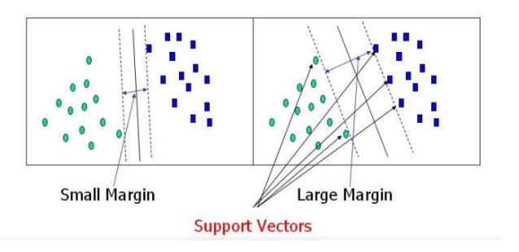
Support Vectors

Slide 13
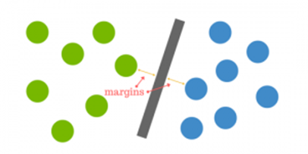
How do we find right hyperplane
•How do we best segregate the two classes within the data?
•The distance between the hyperplane and the nearest data point from either set is known as the margin. The goal is to choose a hyperplane with the greatest possible margin between the hyperplane and any point within the training set, giving a greater chance of new data being classified correctly. There will never be any data point inside the margin.

Slide 14
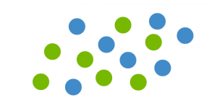
But what happens when there is no clear hyperplane?
•Data are rarely ever as clean as our simple example above. A dataset will often look more like the jumbled balls below which represent a linearly non separable dataset.
In order to classify a dataset like the one above it’s necessary to move away from a 2d view of the data to a 3d view. Explaining this is easiest with another simplified example. Imagine that our two sets of colored balls above are sitting on a sheet and this sheet is lifted suddenly, launching the balls into the air.

Slide 15
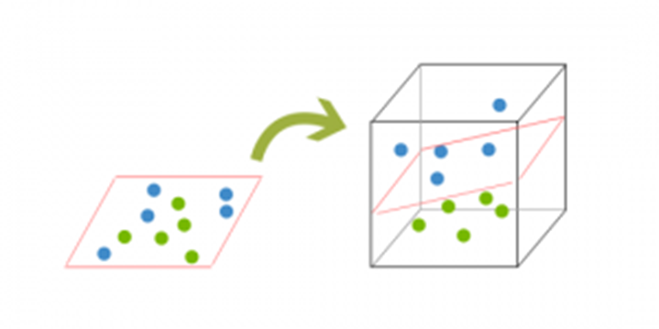
But what happens when there is no no clear hyperplane?
This ‘lifting’ of the balls represents the mapping of data into a higher dimension. This is known as kernelling.The idea is that the data will continue to be mapped into higher and higher dimensions until a hyperplane can be formed to segregate it.

Slide 16
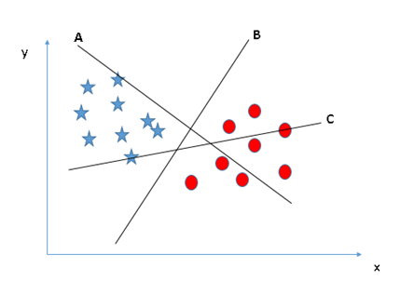
Identify the the right hyperplane (Scenario-1):
Here, we have three hyperplanes (A, B and C). Now, identify the right hyperplane to classify star and circle.
Hyperplane “B” has excellently performed this job.

Slide 17
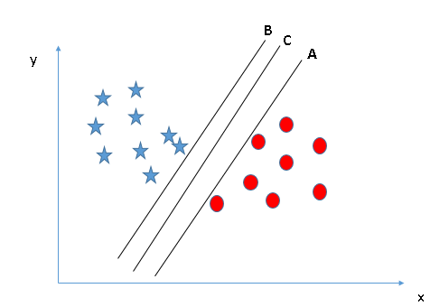
Identify the the right hyperplane (Scenario-2):
Here, we have three hyperplanes (A, B and C) and all are segregating the classes well. Now, how can we identify the right hyperplane?
Here, maximizing the distances between nearest data point (either class) and hyperplane will help us to decide the right hyperplane.

Slide 18
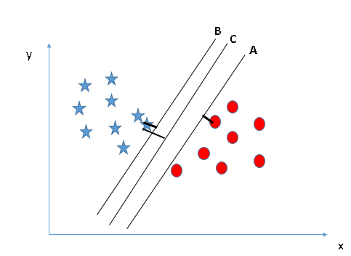
Scenario-2:
This distance is called as Margin. Let’s look at the below snapshot:
We can see that the margin for hyperplane C is high as compared to both A and B. Hence, we name the right hyperplane as C. Another lightning reason for selecting the hyperplane with higher margin is robustness. If we select a hyperplane having low margin then there is high chance of miss classification.

Slide 19
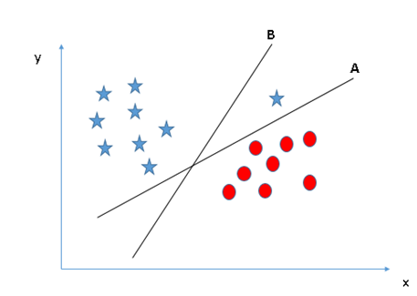
Identify the the right hyperplane (Scenario-3):
Some of you may have selected the hyper-plane B as it has higher margin compared to A. But, here is the catch, SVM selects the hyperplane which classifies the classes accurately prior to maximizing margin. Here, hyperplane B has a classification error and A has classified all correctly. Therefore, the right hyperplane is A.

Slide 20
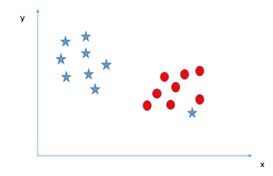
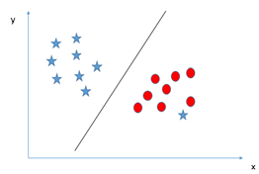
Can we classify two classes
(Scenario-4):
We are unable to segregate the two classes using a straight line, as one of star lies in the territory of other (circle) class as an outlier.
One star at other end is like an outlier for star class. SVM has a feature to ignore outliers and find the hyperplane that has maximum margin. Hence, we can say, SVM is robust to outliers.

Slide 21
Kernel trick:
In SVM, it is easy to have a linear hyperplane between the two classes. But, another burning question which arises is, should we need to add this feature manually to have a hyperplane. No, SVM has a technique called the kernel trick.
These are functions which takes low dimensional input space and transform it to a higher dimensional space i.e. it converts not separable problem to separable problem, these functions are called kernels. It is mostly useful in non-linear separation problem. Simply put, it does some extremely complex data transformations, then find out the process to separate the data based on the labels or outputs you’ve defined.

Slide 22
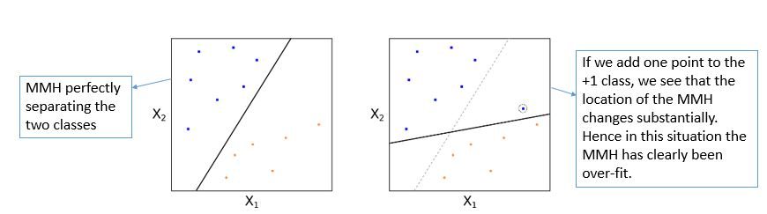
Support Vector Classifiers:
Essentially we have to relax the requirement that a separating hyperplane will perfectly separate every training observation on the correct side of the line (i.e. guarantee that it is associated with its true class label), using what is called a soft margin. This motivates the concept of a support vector classifier(SVC).

Slide 23
Strengths of SVM:
SVM can be used for both Classification(Binary Classification) and Regression.
It is robust,i.e. not much impacted by data with noise or outliers.
The prediction results using this model are very promising.

Slide 24
Applications of SVM:
SVM has been used successfully in many real-world problems
- Text (and hypertext) categorization
- Image classification
- Bioinformatics (Protein classification,
Cancer classification)
- Handwritten character,digit recognition

